Slide 1

IOT

Slide 2





Group members
Thùy Dương
SE171916
Đoan Trinh
SE171941
Văn Quyến
SE171910
Minh Thư
SE171876
Đức Đạt
SE171888
Group 3

Slide 3
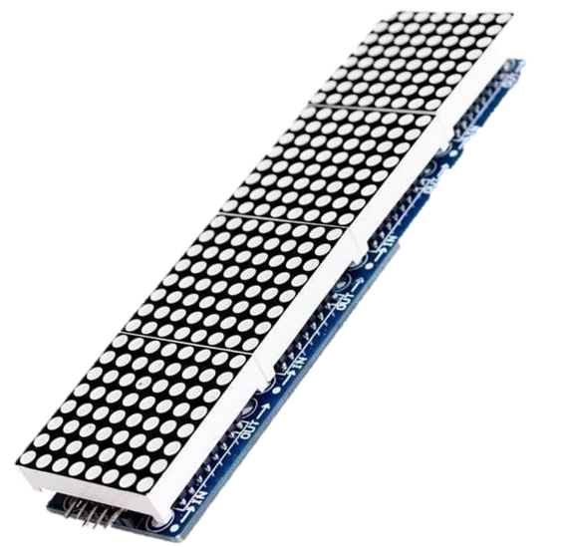
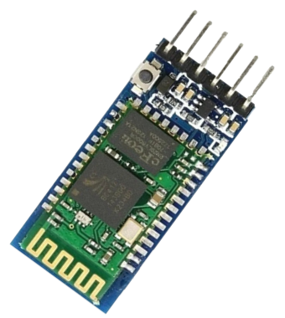
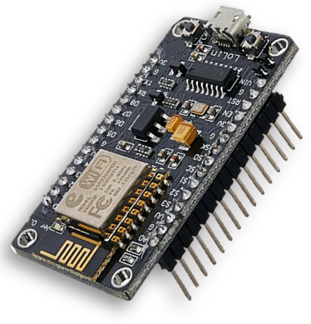
0
1
WELCOME
NodeMCU ESP8266.
2
3
Notes:
NodeMCU ESP8266

Slide 4
1
0
2
WELCOME
BLUETOOH MODULE
NodeMCU ESP8266.
3
4
5
Notes:
BLUETOOTH MODULE

Slide 5
1
2
0
3
WELCOME
MODULE MATRIX 8x32 LED
BLUETOOH MODULE
4
5
Notes:
Module Matrix 8x32 LED

Slide 6

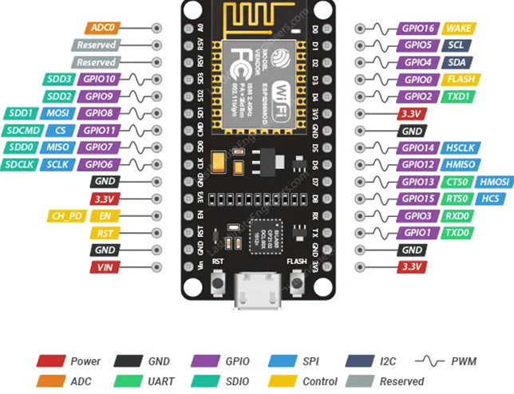
WELCOME
NodeMCU ESP8266
function
operation
services
use
configuration
Notes:
Configuration

Slide 7
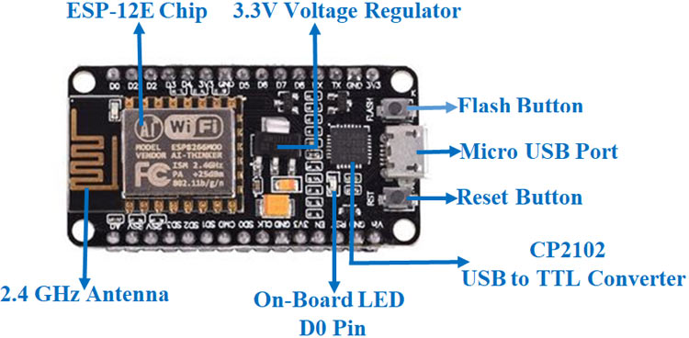
CONFIGURATION
- SRAM: 64 KB
- Clock speed: 80 MHz
- Types of pins include: Power, GND, GPIO, SPI, I2C, PWM, ADC, UART, SDIO, Control, Reserved.
function
operation
use
services
configuration
- Microcontroller: The CPU is a 32-bit Tensilica Xtensa LX106 RISC processor
- Operating voltage: 3.3V
- Input voltage: 7-12V from the VIN pin or 5V from the micro USB port.
- Digital I/O pins (DIO): 16
- Analog input pins (ADC): 1
- Interfaces: UART, SPI, I2C
- Flash memory: 4 MB
Notes:
Operating voltage: 3.3V Types of pins include: Power, GND, GPIO, SPI, I2C, PWM, ADC, UART, SDIO, Control, Reserved.

Slide 8
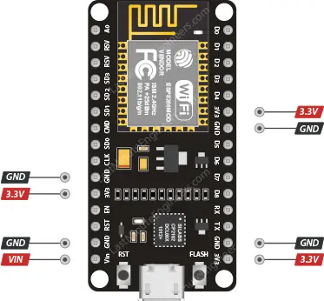
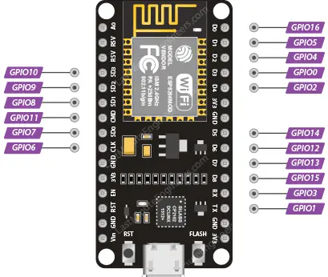
FUNCTION OF THE PINS
2. GPIO pins (General-Purpose Input/Output pins)
1. POWER PIN
operation
function
services
use
configuration
- Total: 17 GPIO pins.
- Each GPIO can be configured internally to the either HIGH or LOW
Notes:
Each GPIO can be configured internally to be either HIGH or LOW.

Slide 9
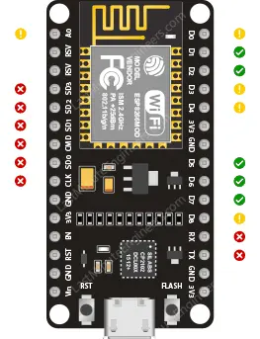
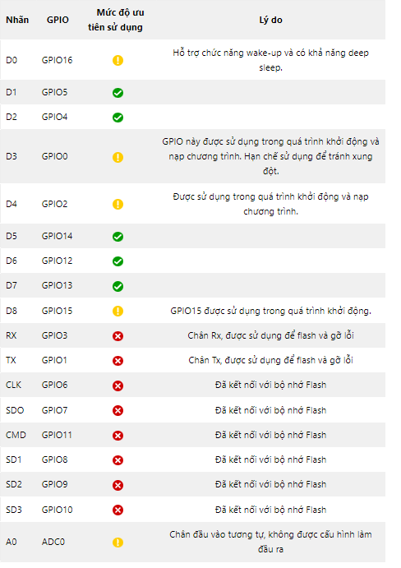
FUNCTION OF THE PINS
Which GPIO pins of ESP8266 are safe to use?
operation
function
services
use
configuration
Notes:
Which GPIO pins of ESP8266 are safe to use?

Slide 10
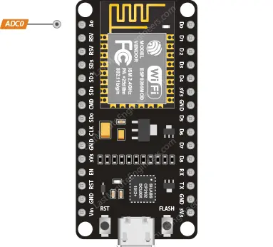
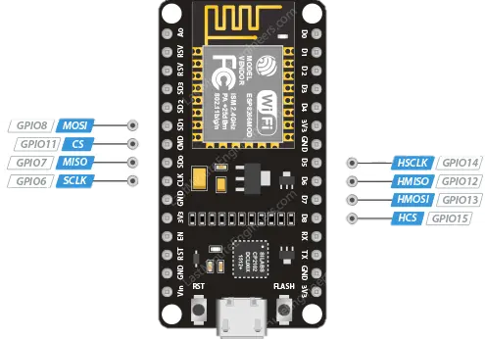
FUNCTION OF THE PINS
3. ADC PIN
4. SPI PIN
operation
function
services
use
configuration
- Read values: 0V → 3.3V
- Two main SPI types: Primary SPI (SPI) and Secondary SPI (HSPI).
- Analog value read from the ADC pin will be converted to a value ranging from 0 to 1023
- 80Hz
- Both support FIFO with a 64-byte buffer
Notes:
Both support FIFO (First-In-First-Out) with a 64-byte buffer.

Slide 11
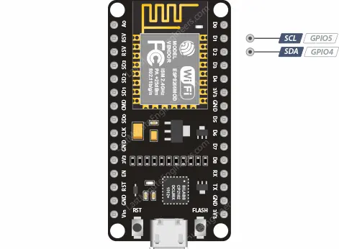
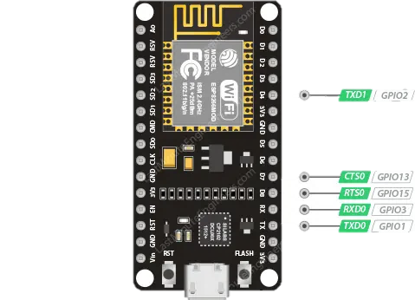
FUNCTION OF THE PINS
5. I2C PIN
6. UART PIN
operation
function
services
use
configuration
- UART0 và UART1
- GPIO4 (SDA) và GPIO5 (SCL)
- TXD0 (Transmit Data 0), RXD0 (Receive Data 0), RST0 (Reset 0) và CTS0 (Clear To Send 0)
- wire.begin(SDA, SCL)
- UART1 communication → TXD1 (Transmit Data 1) pin.
Notes:
Both support FIFO (First-In-First-Out) with a 64-byte buffer.

Slide 12
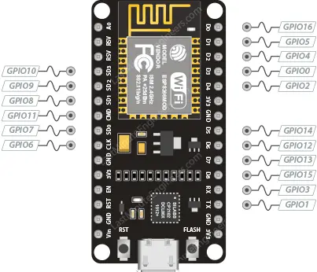
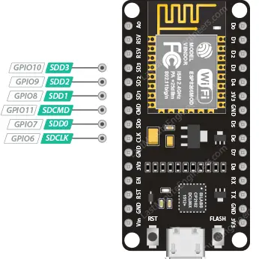
FUNCTION OF THE PINS
7. PWM PIN
8. SDIO PIN
operation
function
services
use
configuration
- From GPIO0 to GPIO15
- ESP8266: PWM signals 10-bit resolution
- Supports SDIO v1.1 (4-bit 25 MHz) and SDIO v2.0 (4-bit 50 MHz).
- Frequency range of PWM signal: ~100Hz to 1kHz. Time period: ~1000 μs to 10000 μs.
Notes:
frequency range of the PWM signal is from approximately 100 Hz to 1 kHz.

Slide 13
FUNCTION OF THE PINS
9. INTERRUPT PIN
operation
function
services
use
configuration
All GPIO pins, except GPIO16.
Notes:
Interrupt

Slide 14
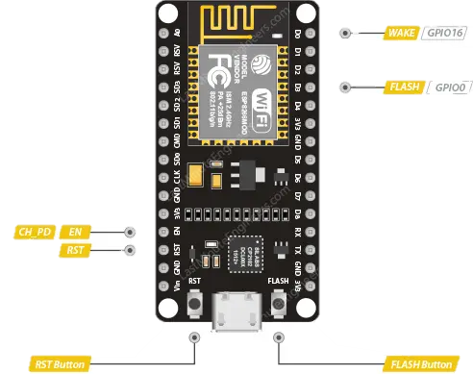
FUNCTION OF THE PINS
10. CONTROL PIN
- EN Pin (CH_PD hoặc Chip Power Down):
+ Default: HIGH level
+ When pulled up to a HIGH level: chip is activated. LOW: chip is disabled
operation
function
services
use
configuration
- RST pin:
+ Default: HIGH level
+ When brought down to a LOW level for a short period: restart.
- FLASH pin:
+ Determines when to enter programming mode during startup.
- WAKE pin:
+ Wake up the ESP8266 from deep sleep mode.
+ LOW level during startup: initiates the programming process.
Notes:
Interrupt

Slide 15
PRINCIPLE OF OPERATION
1. Boot
2. System and Memory Initialization
3. Environment Check.
4. Wi-Fi Initialization
services
function
use
operation
5. Run User Program
configuration
6. GPIO Communication and Sensor Interaction
7. Wi-Fi Communication and MQTT/HTTP
8. Power Saving Mode
9. UART (Serial Communication)

Slide 16
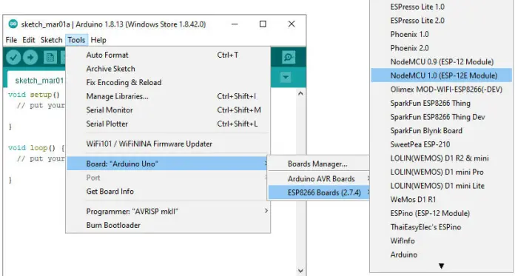
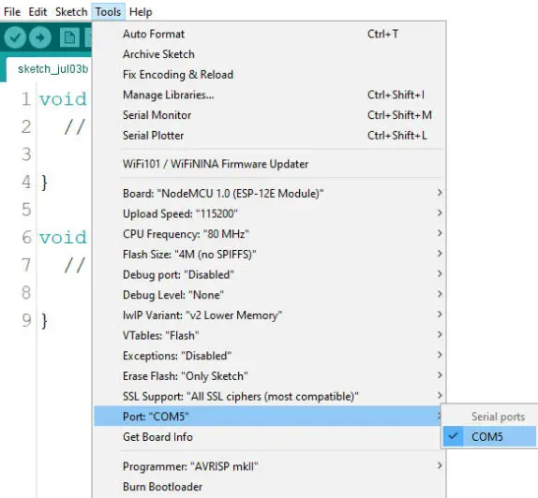
HOW TO USE
Connecting NodeMCU to the Computer:
services
use
function
timeline
configuration
Use a Micro USB cable to connect NodeMCU to your computer. Ensure that NodeMCU is recognized and has the appropriate drivers installed

Slide 17
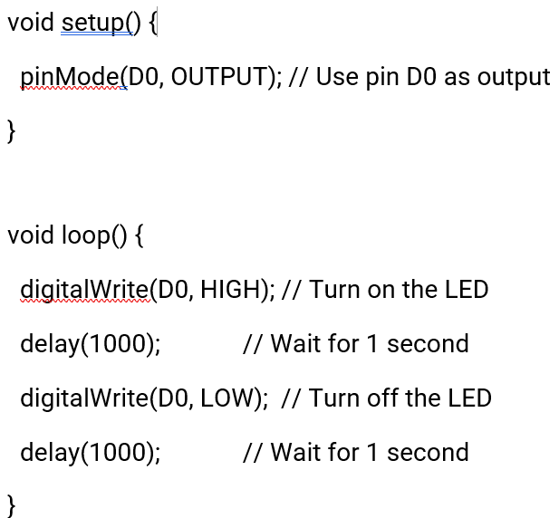
HOW TO USE
Write and Upload a Simple Program:
For example, you can use the Blink program to make the LED on NodeMCU flash.
services
use
function
timeline
configuration
● Check the Results
● Develop IoT Applications
● Wi-Fi Communication and MQTT
● Monitoring and Debugging

Slide 18
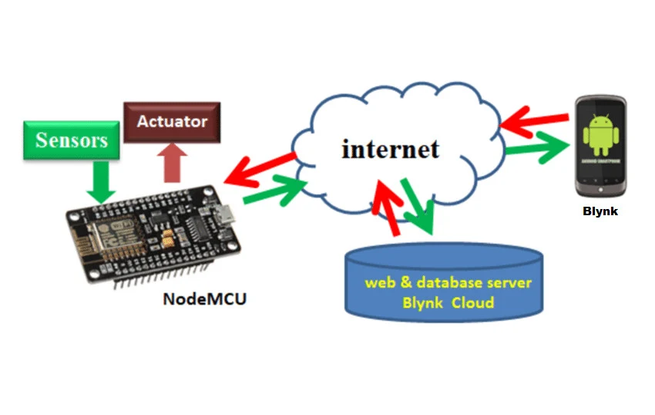
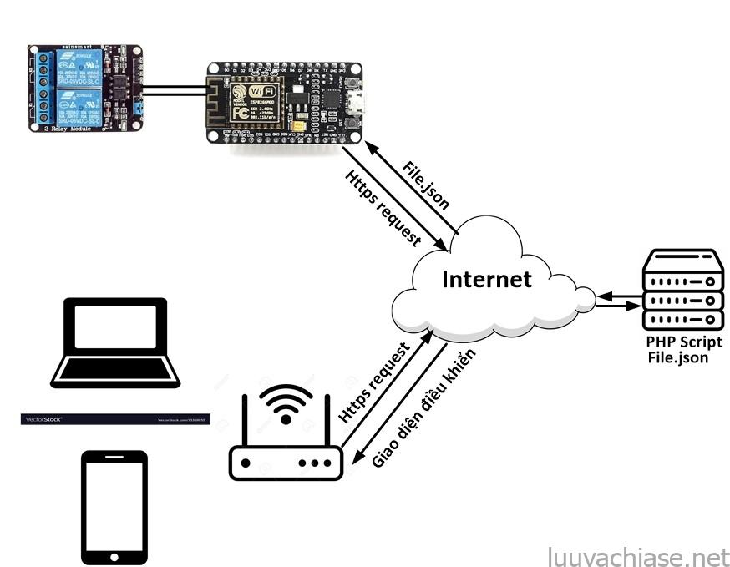



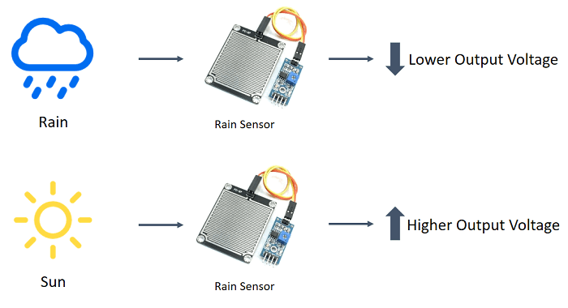



APPLICATION
Home automation.
Collecting data from sensors.
services
function
use
timeline
configuration
Measuring power consumption.
Controlling via Wi-Fi.
Internet Smoked Alarm

Slide 19
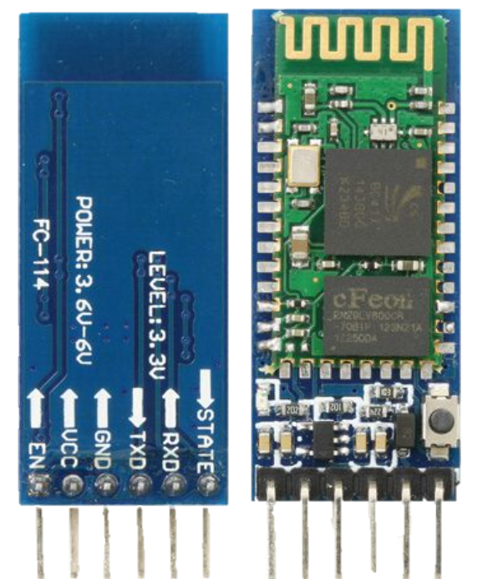
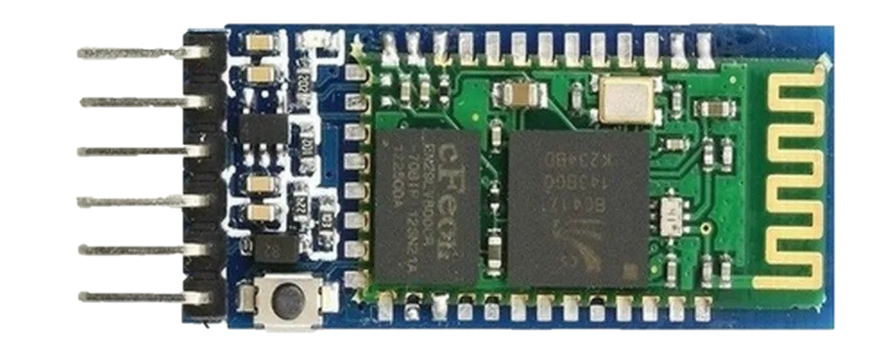
CONFIGURATION
55%
D
BLUETOOTH MODULE
35%
65%
65%
55%
C
B
CONFIGURATION
TYPE YOUR TEXT
TYPE YOUR TEXT
TYPE YOUR TEXT
A
FUNCTION OF THE PINS
PRINCIPLE OF OPERATION
35%
HOW TO USE
85%
1. Frequency: 2.4 GHz ISM band
25%
35%
2. Operating voltage: 3.3V to 5V
WRITE SOME TEXT HERE
APPLICATION
3. IC: BC417
TYPE YOUR TEXT
TYPE YOUR TEXT
A
B
C
TYPE YOUR TEXT
4. Flash memory: 8Mbit
5. Bluetooth version: 2.0 + EDR (Enhanced Data Rate)
6. Bluetooth system: Bluetooth CSR Bluecore 04 external single chip with CMOS technology

Slide 20
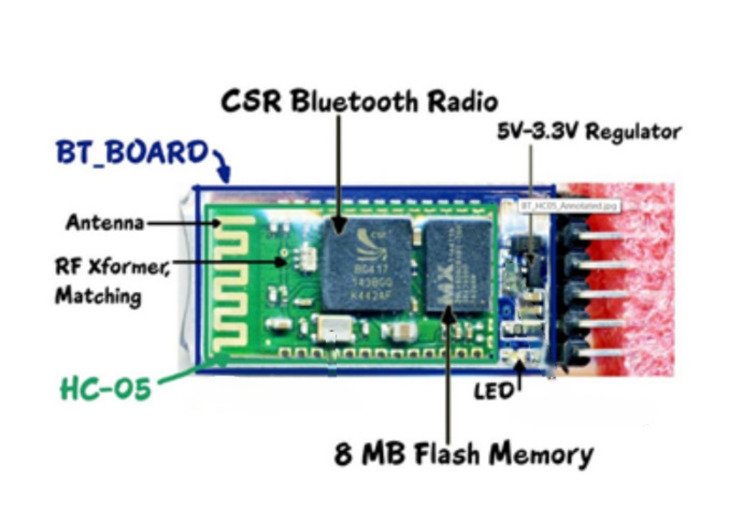
CONFIGURATION
55%
D
35%
65%
65%
55%
C
B
TYPE YOUR TEXT
TYPE YOUR TEXT
TYPE YOUR TEXT
A
85%
25%
35%
35%
1. Frequency: 2.4 GHz ISM band
7. Protocol: IEEE 802.15.1 standard
WRITE SOME TEXT HERE
2. Operating voltage: 3.3V to 5V
A
B
C
3. IC: BC417
TYPE YOUR TEXT
TYPE YOUR TEXT
TYPE YOUR TEXT
4. Flash memory: 8Mbit
5. Bluetooth version: 2.0 + EDR (Enhanced Data Rate)
6. Bluetooth system: Bluetooth CSR Bluecore 04 external single chip with CMOS technology

Slide 21
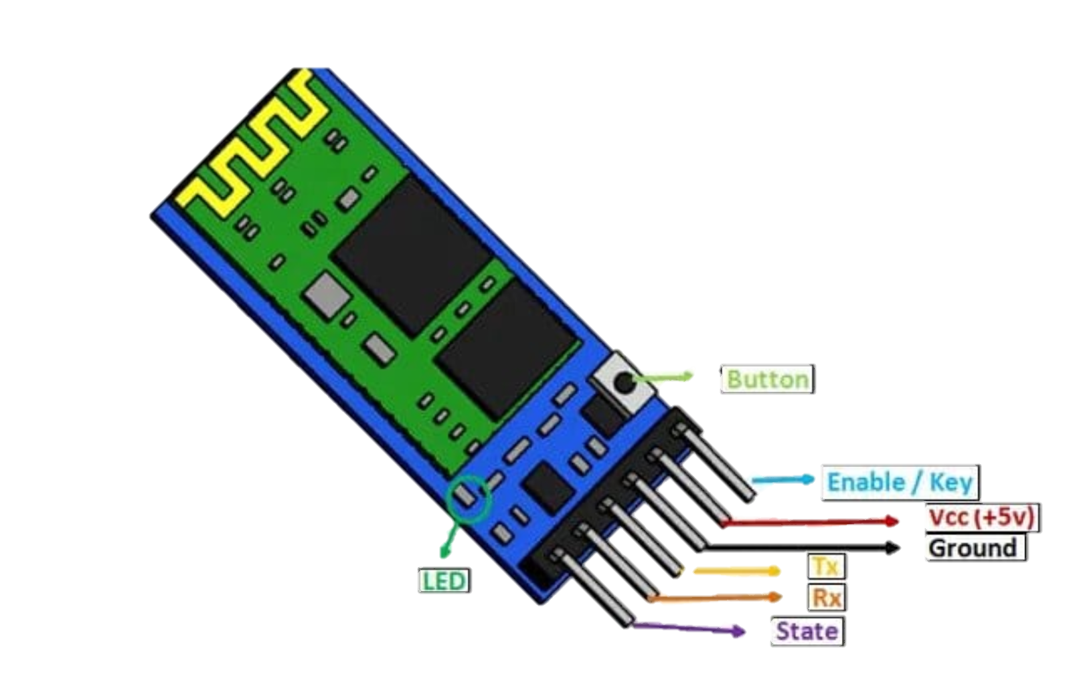
CONFIGURATION
FUNCTION OF THE PINS
1. VCC: Connect 5 V or 3.3 V to this Pin
D
2. GND: Ground Pin of module
65%
65%
55%
C
3. TXD: Transmit Serial data
4. RXD: Receive data serially
B
5. State: It tells whether module is connected or not.
TYPE YOUR TEXT
TYPE YOUR TEXT
TYPE YOUR TEXT
A
85%
25%
35%
1. Frequency: 2.4 GHz ISM band
7. Protocol: IEEE 802.15.1 standard
6. Enable/Key: The pin changes mode between data mode and command line mode by providing an external signal
2. Operating voltage: 3.3V to 5V
A
B
C
3. IC: BC417
TYPE YOUR TEXT
TYPE YOUR TEXT
TYPE YOUR TEXT
4. Flash memory: 8Mbit
7. Button: Change data and command modes
5. Bluetooth version: 2.0 + EDR (Enhanced Data Rate)
8. LED: shows the status of Module HC-05
6. Bluetooth system: Bluetooth CSR Bluecore 04 external single chip with CMOS technology

Slide 22
CONFIGURATION
PRINCIPLE OF OPERATION
D
65%
65%
55%
C
B
TYPE YOUR TEXT
TYPE YOUR TEXT
TYPE YOUR TEXT
A
- Based on sequential communication protocol.
- Receive data and remove the beginning and end, then pass it through UART.
85%
25%
35%
1. Frequency: 2.4 GHz ISM band
7. Protocol: IEEE 802.15.1 standard
- Builds a Bluetooth packet and sends it over a Bluetooth wireless connection to the receiving device
2. Operating voltage: 3.3V to 5V
A
B
C
3. IC: BC417
TYPE YOUR TEXT
TYPE YOUR TEXT
TYPE YOUR TEXT
- HC-05 has two operating modes:
+ Command Mode:You can communicate with the Bluetooth module via AT commands
Ex: AT + NAME = ****** : To set/change device name
+ Data Mode: used to communicate with other Bluetooth devices
4. Flash memory: 8Mbit
5. Bluetooth version: 2.0 + EDR (Enhanced Data Rate)
6. Bluetooth system: Bluetooth CSR Bluecore 04 external single chip with CMOS technology

Slide 23
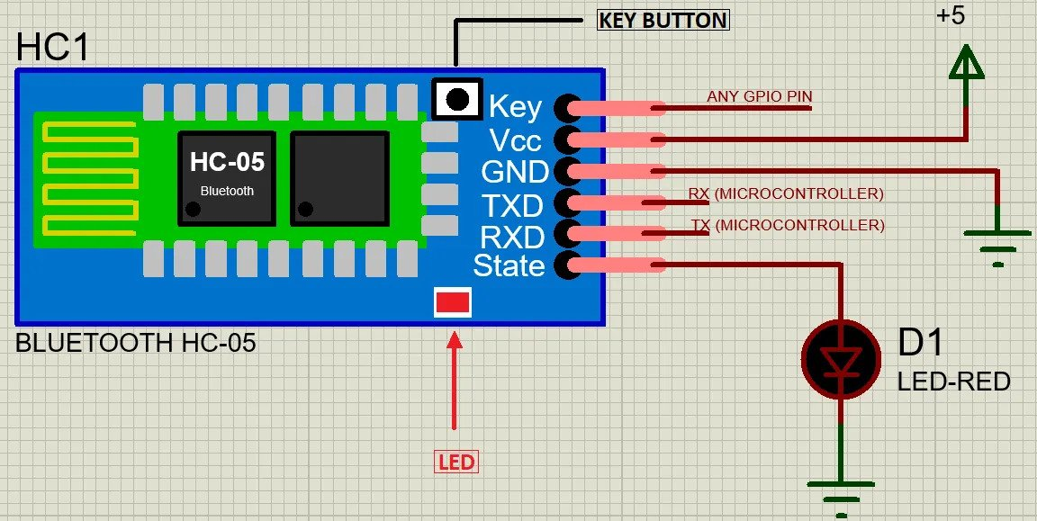
CONFIGURATION
PRINCIPLE OF OPERATIO
HOW TO USE
1. The TX will communicate with the controller's RX and the RX will communicate with the microcontroller's TX
D
65%
65%
55%
2. There is a third pin (Key) used to switch modes.
C
3. When no input signal is fed to the Key pin, the device will operate in data mode.
B
TYPE YOUR TEXT
TYPE YOUR TEXT
TYPE YOUR TEXT
A
4. After feeding a logical input signal to this pin, the device enters command line mode.
- Based on sequential communication protocol.
- Receive data and remove the beginning and end, then pass it through UART.
85%
25%
35%
1. Frequency: 2.4 GHz ISM band
7. Protocol: IEEE 802.15.1 standard
- Builds a Bluetooth packet and sends it over a Bluetooth wireless connection to the receiving device
2. Operating voltage: 3.3V to 5V
3. IC: BC417
TYPE YOUR TEXT
TYPE YOUR TEXT
TYPE YOUR TEXT
- HC-05 has two operating modes:
+ Command Mode:You can communicate with the Bluetooth module via AT commands
Ex: AT + NAME = ****** : To set/change device name
+ Data Mode: used to communicate with other Bluetooth devices
4. Flash memory: 8Mbit
5. Bluetooth version: 2.0 + EDR (Enhanced Data Rate)
6. Bluetooth system: Bluetooth CSR Bluecore 04 external single chip with CMOS technology

Slide 24
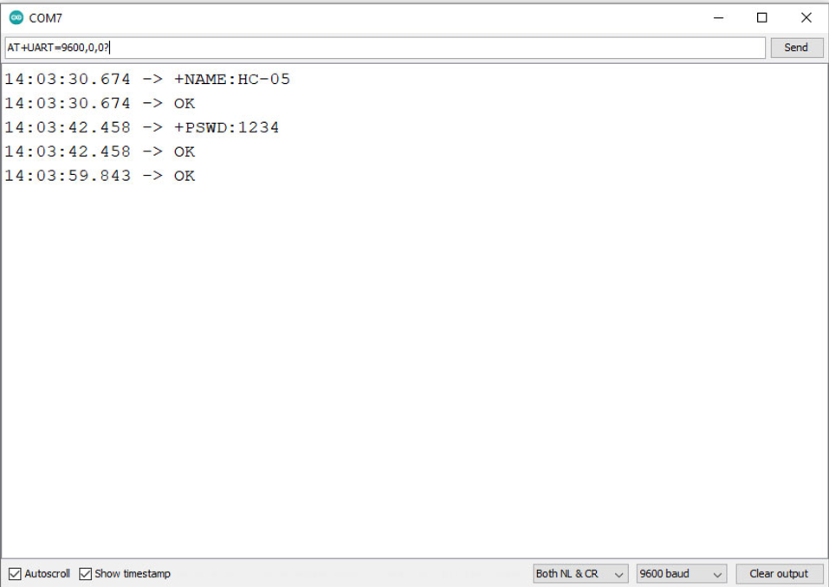
CONFIGURATION
PRINCIPLE OF OPERATIO
HOW TO USE
5. After entering command line mode, the module's default settings may change when using the following commands:
D
>> AT - To check the connection
65%
65%
55%
C
>> AT + NAME = ****** - To set/change the device name
>> AT + UART = *****, *, * - To set the transfer rate, stop bit and parity bit
B
TYPE YOUR TEXT
TYPE YOUR TEXT
TYPE YOUR TEXT
>>AT + VERSION? - Display version of Bluetooth module
A
>>AT + ORGL - The command to save settings has been executed
- Based on sequential communication protocol.
- Receive data and remove the beginning and end, then pass it through UART.
85%
25%
35%
1. Frequency: 2.4 GHz ISM band
7. Protocol: IEEE 802.15.1 standard
- Builds a Bluetooth packet and sends it over a Bluetooth wireless connection to the receiving device
2. Operating voltage: 3.3V to 5V
3. IC: BC417
TYPE YOUR TEXT
TYPE YOUR TEXT
TYPE YOUR TEXT
- HC-05 has two operating modes:
+ Command Mode:You can communicate with the Bluetooth module via AT commands
Ex: AT + NAME = ****** : To set/change device name
+ Data Mode: used to communicate with other Bluetooth devices
4. Flash memory: 8Mbit
5. Bluetooth version: 2.0 + EDR (Enhanced Data Rate)
6. Bluetooth system: Bluetooth CSR Bluecore 04 external single chip with CMOS technology

Slide 25
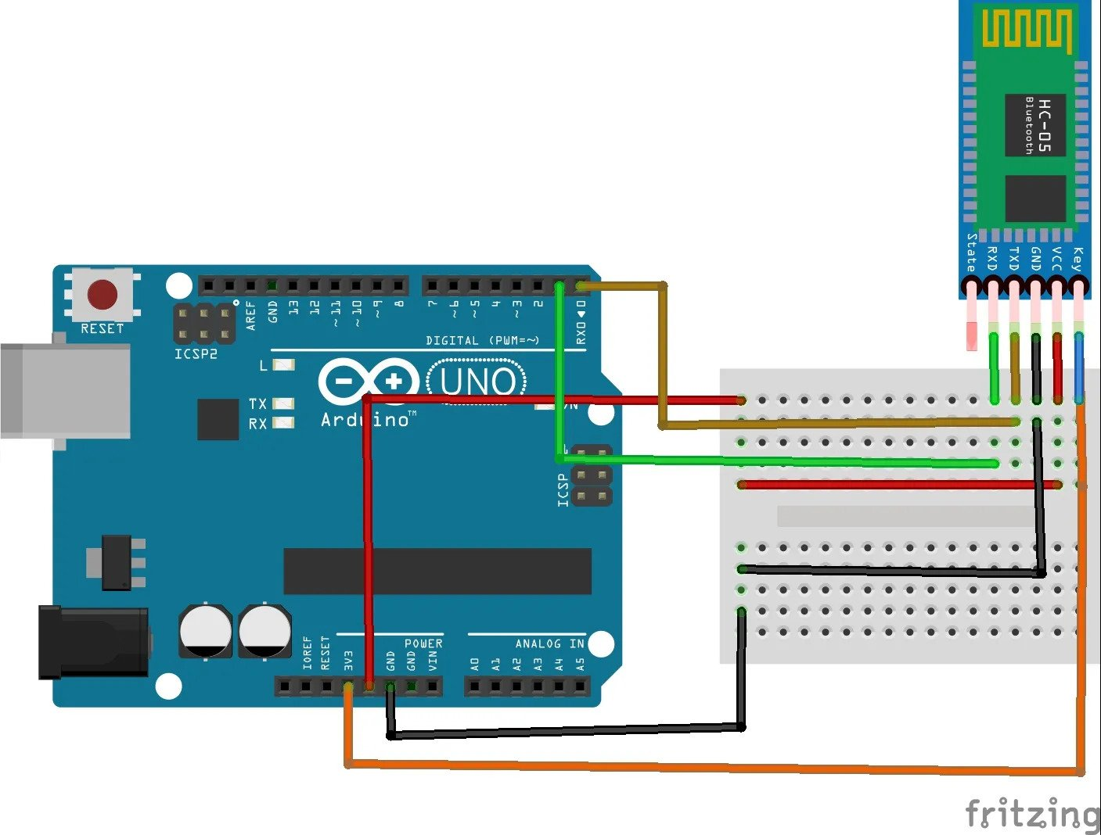
CONFIGURATION
PRINCIPLE OF OPERATIO
HOW TO USE
6. When the KEY pin is not plugged into the computer, it is connected to GND (Data mode)
D
65%
65%
55%
7. After plugging into the computer, we change the KEY pin through the 3V3 port (Command mode)
C
B
TYPE YOUR TEXT
TYPE YOUR TEXT
TYPE YOUR TEXT
A
- Based on sequential communication protocol.
- Receive data and remove the beginning and end, then pass it through UART.
85%
25%
35%
1. Frequency: 2.4 GHz ISM band
7. Protocol: IEEE 802.15.1 standard
- Builds a Bluetooth packet and sends it over a Bluetooth wireless connection to the receiving device
2. Operating voltage: 3.3V to 5V
3. IC: BC417
TYPE YOUR TEXT
TYPE YOUR TEXT
TYPE YOUR TEXT
- HC-05 has two operating modes:
+ Command Mode:You can communicate with the Bluetooth module via AT commands
Ex: AT + NAME = ****** : To set/change device name
+ Data Mode: used to communicate with other Bluetooth devices
4. Flash memory: 8Mbit
5. Bluetooth version: 2.0 + EDR (Enhanced Data Rate)
6. Bluetooth system: Bluetooth CSR Bluecore 04 external single chip with CMOS technology
8. Open the serial and switch Baud to 38400 then switch back to 9600 (baud rate adjustment)

Slide 26



CONFIGURATION
PRINCIPLE OF OPERATIO
FUNCTION OF THE PINS
HOW TO USE
1. Embedded project.
6. When the KEY pin is not plugged into the computer, it is connected to GND (Data mode)
D
2. Data transfer between two HC-05 modules.
7. After plugging into the computer, we change the KEY pin via VCC 5V (or through the 3V3) (Command mode)
C
3. Send data from HC-05 to another Bluetooth device.
B
4. Control the device remotely via Bluetooth.
A
5. Control the robot via Bluetooth.
- Based on sequential communication protocol.
6. Wireless headphones and mouse.
- Receive data and remove the beginning and end, then pass it through UART.
1. Frequency: 2.4 GHz ISM band
7. Protocol: IEEE 802.15.1 standard
- Builds a Bluetooth packet and sends it over a Bluetooth wireless connection to the receiving device
2. Operating voltage: 3.3V to 5V
3. IC: BC417
- HC-05 has two operating modes:
+ Command Mode:You can communicate with the Bluetooth module via AT commands
Ex: AT + NAME = ****** : To set/change device name
+ Data Mode: used to communicate with other Bluetooth devices
4. Flash memory: 8Mbit
5. Bluetooth version: 2.0 + EDR (Enhanced Data Rate)
6. Bluetooth system: Bluetooth CSR Bluecore 04 external single chip with CMOS technology
8. Open the serial and switch Baud to 38400 then switch back to 9600 (baud rate adjustment)

Slide 27
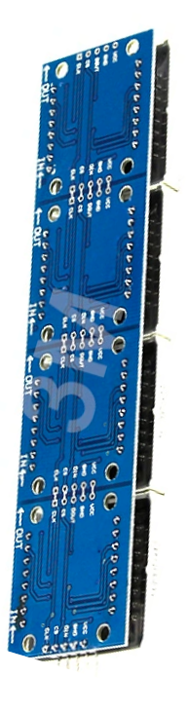

Slide 6
Slide 5
Welcome to Module Matrix 8x32 LED
Slide 4
MAX7219 Arduino Xanh Dương MT-832-G
Slide 3
Slide 2
Slide 1

Slide 28
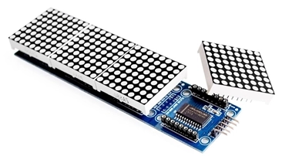
CONFIGURATION
Slide 6
● Size: 8x32 LEDs, consisting of 4 matrices 8x8 stitched together.
● Blue LED Matrix
Slide 5
● Operating Voltage: 5V
● IC driver: MAX7219
● Dimensions: Length: 130mm. Height: 32mm. Width: 14mm
Slide 4
● Communication follows the SPI standard, utilizing RCLK and DIO.
Slide 3
Slide 2
Slide 1
Notes:
Configuration

Slide 29
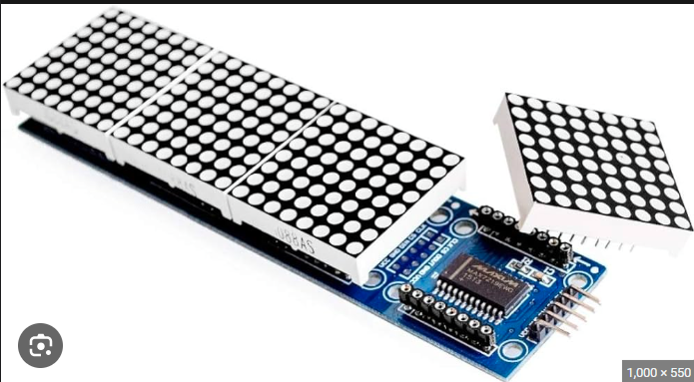
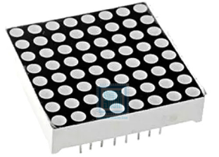
PRINCIPLE OF OPERATION
32 Columns
Slide 6
Slide 5
8 Rows
Slide 4
Slide 3
8 Columns
8 Rows
Slide 2
Slide 1
Notes:
Principle of operation

Slide 30
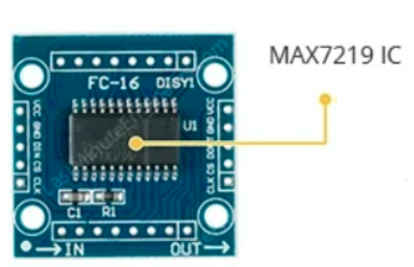
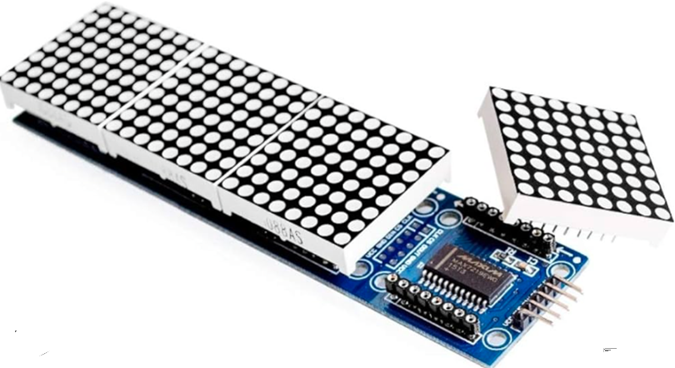
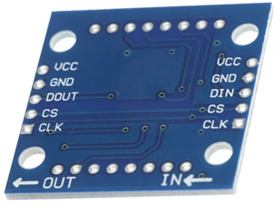
PRINCIPLE OF OPERATION
Slide 6
Slide 5
Slide 4
Slide 3
Slide 2
Slide 1
Notes:
Principle of operation

Slide 31
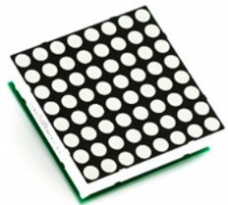
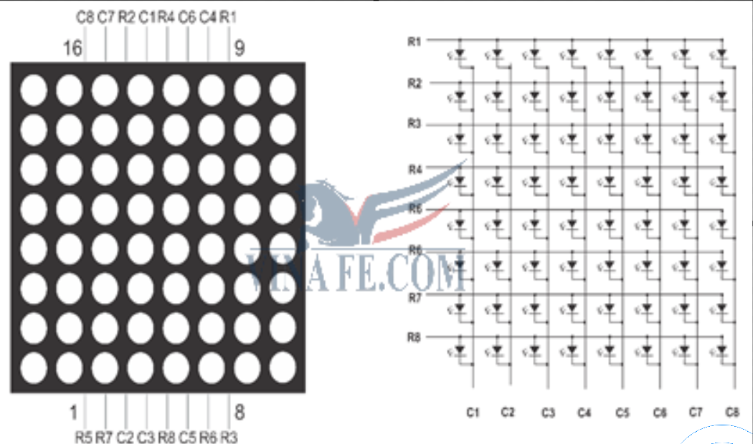
PRINCIPLE OF OPERATION
● Connecting all rows and columns together is done to reduce the number of pins required to control each LED dot.
Slide 6
Row
Slide 5
Anode
Slide 4
Slide 3
Slide 2
Column
Slide 1
→ Multiplexing
Cathode
Notes:
Serial Peripheral Interface

Slide 32
PRINCIPLE OF OPERATION
Slide 6
Slide 5
Slide 4
Slide 3
● MAX7219 is an Integrated Circuit (IC).
● Used to connect multiple LED displays or LED matrices.
Slide 2
● It reduces the complexity of controlling LEDs and displaying numbers or characters.
Slide 1
● It handles all control and refresh tasks → sent via SPI communication.
Notes:
Principle of operationSerial Peripheral Interface

Slide 33
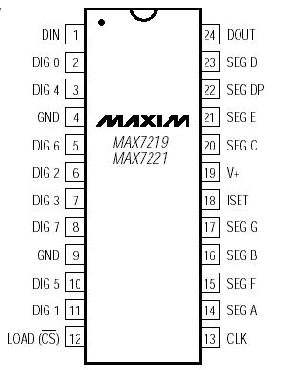
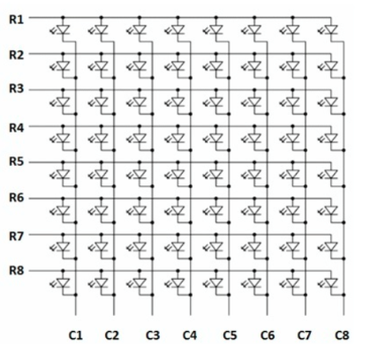
PRINCIPLE OF OPERATION
Slide 6
Slide 5
Slide 4
Slide 3
Slide 2
Slide 1
Notes:
Principle of operation

Slide 34
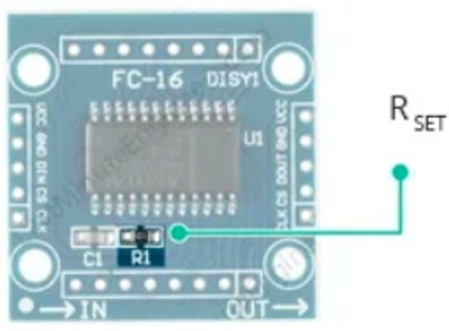
PRINCIPLE OF OPERATION
Slide 6
Slide 5
Slide 4
Slide 3
● RSet resistor: used to adjust the brightness of the LED matrix.
Slide 2
● Control the maximum current supplied to the LED.
Slide 1
Notes:
Principle of operation

Slide 35
PRINCIPLE OF OPERATION
Slide 6
SPI communication.
Slide 5
● Used to transmit and receive data from Arduino or any other data source.
Slide 4
● This communication includes: CLK (Clock), DIN (Data In), CS (Chip Select), and DOUT
Slide 3
Slide 2
Slide 1
Notes:
Principle of operation

Slide 36
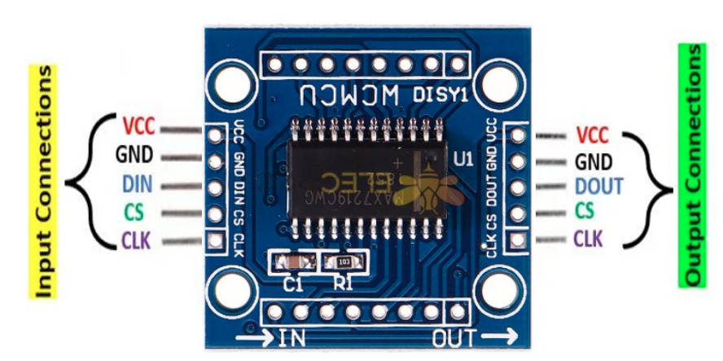
FUNCTION OF THE PINS
Slide 6
Slide 5
Slide 4
Slide 3
Input Connections
● VCC: Connected to 5V (Anode)
● GND: Ground connection (Cathode)
Slide 2
● DIN: Data In pin. Connect it to any digital pin of the microcontroller.
● CS: Chip Select (sometimes labeled as LOAD).
Slide 1
● CLK: Clock pin. This pin receives clock signals to synchronize the data transfer into IC.
Notes:
Function of the pins

Slide 37
FUNCTION OF THE PINS
Slide 6
Slide 5
Slide 4
Slide 3
Output Connections
● VCC: Connect to the 5V pin of the next module.
● GND: Connect to the GND pin of the next module.
Slide 2
● DOUT: Data Out pin, connects to the DIN pin of the next module.
● CS: Connect to the CS/LOAD of the next module.
Slide 1
● CLK: Connect to the CLK pin of the next module.
Notes:
Function of the pins

Slide 38
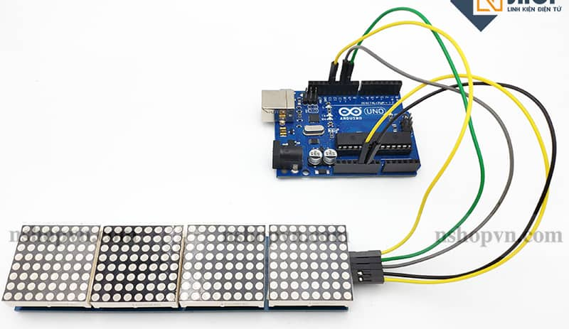
HOW TO USE
● VCC - 5V (VCC is the power supply pin)
Slide 6
● GND - GND
● DIN (Data In) - Digital 11 (This is the pin for transmitting data from the microcontroller to the MAX7219)
Slide 5
● CS - Digital 10 (pin for selecting the operation of the module)
● CLK (Clock pin) - Digital 13 (pin providing clock pulses for the MAX7219)
Slide 4
Slide 3
Slide 2
Slide 1

Slide 39
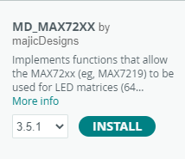
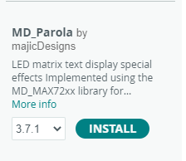
HOW TO USE
Include the two libraries: MD_MAX72xx and MD_Parola.
Slide 6
Slide 5
Slide 4
Slide 3
● Provide functions to configure and control LED devices through SPI communication.
● An extension of MD_MAX72xx
Slide 2
● To simplify the display of text and create motion effects on the LED matrix
Slide 1

Slide 40
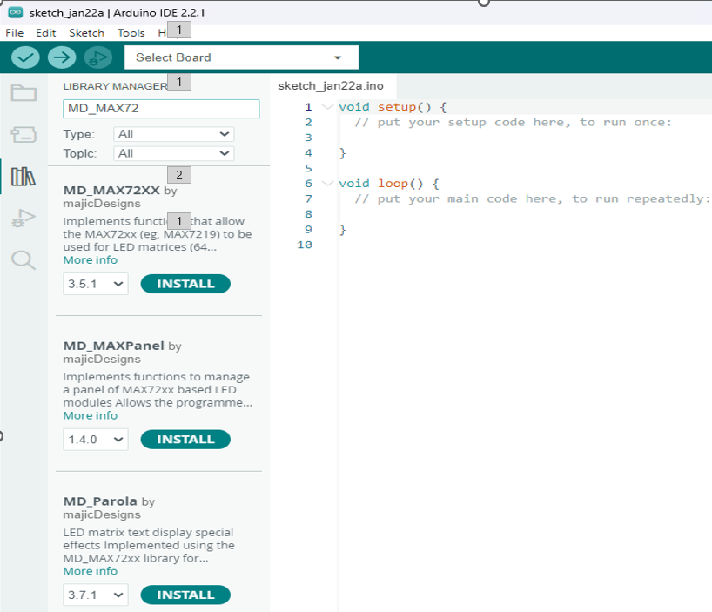
HOW TO USE
The reason for using both libraries:
Slide 6
● Combine the power of MD_MAX72xx for hardware control.
Slide 5
● Leverage the flexibility of MD_Parola for displaying text and effects.
Slide 4
To install:
Slide 3
Open Arduino IDE → select Sketch → Include Library → Manage Libraries, then search for "MD_MAX72xx".
Slide 2
Slide 1

Slide 41
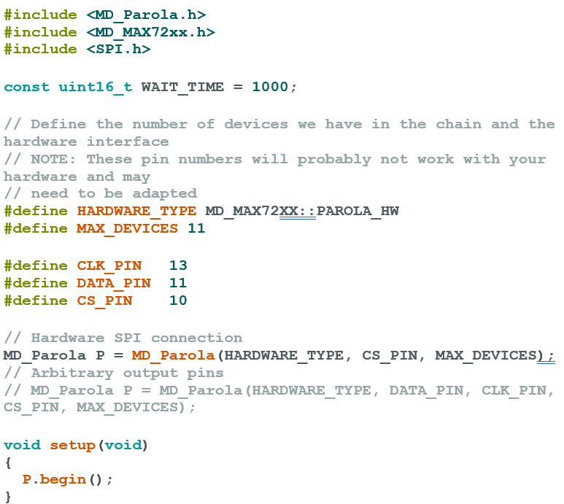
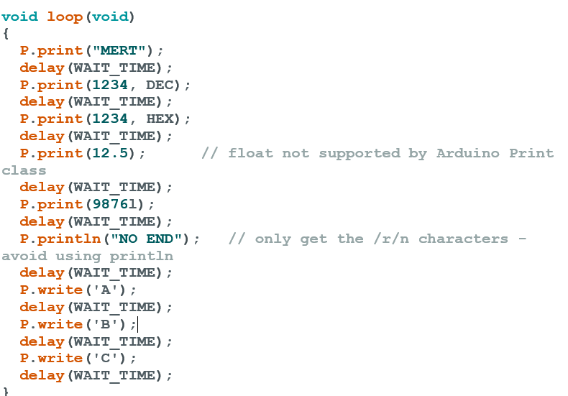
Slide 6
Slide 5
Slide 4
Slide 3
Slide 2
Slide 1

Slide 42
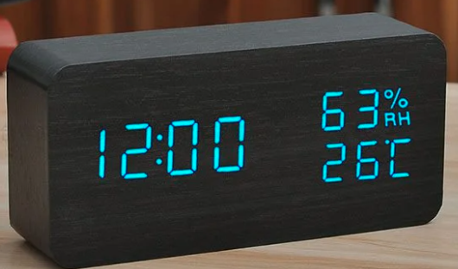




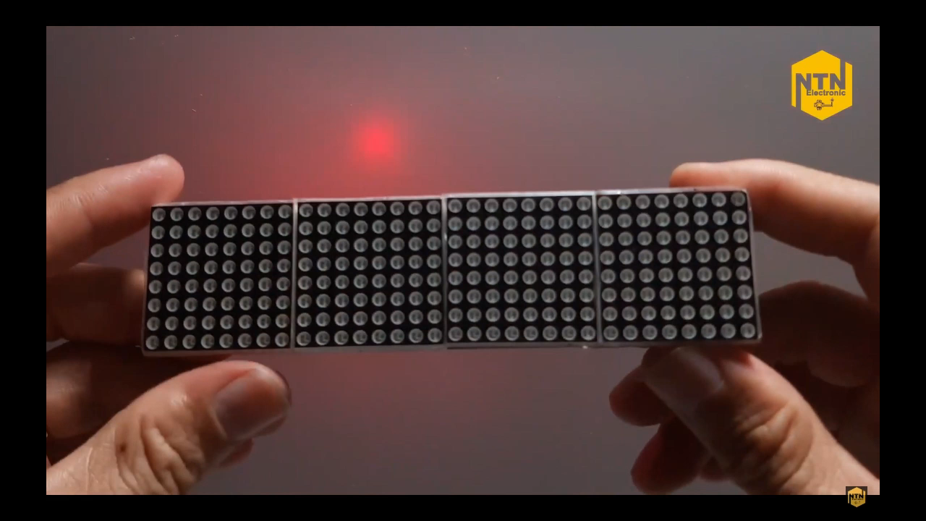


APPLICATION
Slide 6
Display Weather Information
Slide 5
Clock and Alarm
Slide 4
Display Messages and Notifications
Slide 3
Scrolling Text and Text Effects
Slide 2
Display Traffic Route Information
Slide 1
Notes:
Application

Slide 43
Thank you for watching

